Slide 1
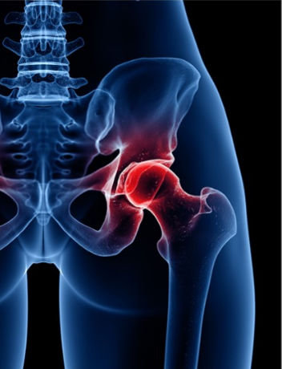
Stony Brook Sports Medicine Update
Department of Orthopaedics
The Hip
September 11, 2020 12pm-2pm
Thank you for joining us for the webinar series comprising the 10th Annual Stony Brook Sports Medicine Update; Women in Sports Medicine

Slide 2
Course Description:
The Stony Brook Department of Orthopaedics invites you to attend the next webinar segment comprising the 10th Annual Stony Brook Sports Medicine Update; Women in Sports Medicine. This mini course is designed to cover the most current evidence based practice related to orthopaedic issues in sports medicine today. The focus of this course is on the hip.
The target audience consists of Physicians, Athletic Trainers, Physical Therapists, Physician Assistants, students, and all of those involved with the care of athletes.

Slide 3
*Important*
Please make sure you are logged in with your full name and title to ensure you are checked off for educational credit verification.
This meeting is being recorded for future use.

Slide 4
Objectives:
Understand normal and pathologic anatomy of the hip
Identify key examination factors in determining the origin of hip pain and use of further imaging
Explore the surgical intervention options for treatment of hip injuries

Slide 5
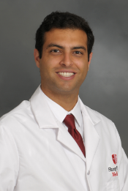
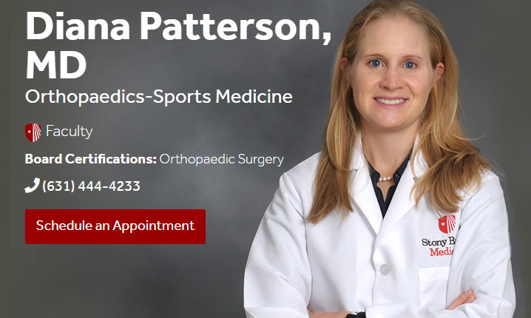
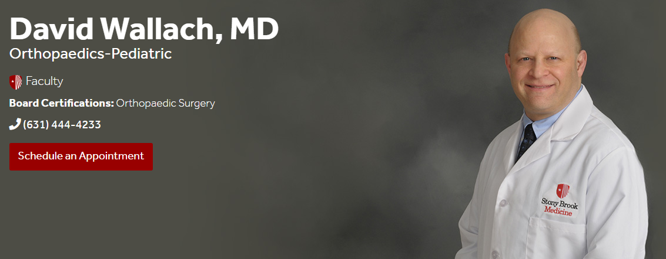
Presenters:
Dr. Alireza Nazemi PGY-3 Orthopaedic Surgery Resident - The Anatomy of the Hip; A Dissection Presentation
Dr. Diana Patterson -Hip Pain, Exam and Imaging
Dr. David Wallach -Hip Arthroscopy, Indications and Techniques

Slide 6
Accreditation:
CME
The School of Medicine, State University of New York at Stony Brook, is accredited by the Accreditation Council for Continuing Medical Education to provide continuing medical education for physicians. The school of Medicine, State University of New York at Stony Brook designates this live activity for a maximum of 2.00 AMA PRA Category 1 Credit(s).™ Physicians should only claim the credit commensurate with the extent of their participation in the activity.
Please contact the Stony Brook School of Medicine Office of Continuing Education at 631-444-2094 to speak with Myra or Donna with CME questions.

Slide 7
Physical Therapy/Athletic Training Credits:
The Office of Continuing Education is not responsible for awarding CEU/CE/Contact hours. You may obtain a letter of participation for hours of learning and submit it to your accrediting agency.
This symposium qualifies for 2 contact hours as recognized by New York State Education Department Board of Physical Therapy. For proof of attendance, please email patricia.lamb@stonybrookmedicine.edu
School of Health Technology and management, Stony Brook University (BOC AP #P3368) is approved by the Board of Certification, Inc. to provide continuing education to Athletic Trainers. This program is eligible for a maximum of 2 Category A CEU’s. AT’s should claim only those hours actually spent in the educational program. For proof of attendance, please email xristos.gaglias@stonybrook.edu with the completed pdf survey form for Athletic Trainers only, which was sent to your email with the Zoom meeting link on September 9. Certificates can take up to 14 days to receive.

Slide 8
Disclosures:
In compliance with the ACCME Standards for Commercial Support, everyone who is in a position to control the content of an educational activity provided by the School of Medicine is expected to disclose to the audience any relevant financial relationships with any commercial interest that relates to the content of his/her presentation.
Dr. Alireza Nazemi, Dr. Diana Patterson, Dr. David Wallach, the faculty, the planners, the reviewers, and the CME provider have no relevant financial relationship with a commercial interest (defined as any entity producing, marketing, re-selling, or distributing health care goods or services consumed by, or used on, patients), that relates to the content that will be discussed in the educational activity.

Slide 10
Questions
You can type your questions in the chat box at any time throughout this meeting. We will have time dedicated after the presentations to answer questions.
10th Annual Stony Brook Sports Medicine Update; Women in Sports Medicine

Slide 11
Questions?
10th Annual Stony Brook Sports Medicine Update; Women in Sports Medicine

Slide 12
Reminder for Physical Therapists/Athletic Trainers
For proof of attendance for Physical Therapists, please email patricia.lamb@stonybrookmedicine.edu
For proof of attendance for Athletic Trainers, please email xristos.gaglias@stonybrook.edu with the completed pdf survey form for Athletic Trainers only, which was sent to your email with the Zoom meeting link on September 9.
Each attendee of this webinar will be send a survey after the completion of this course by the Renaissance School of Medicine. Please complete this survey in a timely manner and leave comments so we can improve future webinars.
For additional questions or concerns, please contact Dana.Bennett@stonybrookmedicine.edu

Slide 13
Stony Brook Medicine Youtube Channel
Visit the Stony Brook Medicine Youtube channel to view this and the other webinars of this series comprising the 10th Annual Stony Brook Sports Medicine Update. The foot and ankle webinar is available for viewing at https://youtu.be/RH89_rhVch4
The knee webinar is available for viewing at https://youtu.be/3v5PLhQM9iw

Slide 15
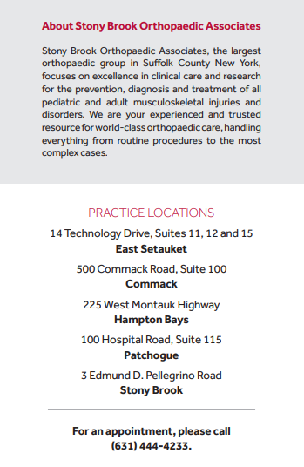

Slide 16
Thank you for attending this webinar.
For Orthopaedic Appointments with one of our physicians, Please call (631) 444-4233 to schedule.
For additional questions or concerns, please contact Dana.Bennett@stonybrookmedicine.edu

